Slide 1


ONLINE SHOPPING SYSTEM
GROUP PROJECT

Slide 2
MEET OUR TEAM
Student 1 Name : EKALKUMAR SORATHIYA
Roll no : 62
Enrollment No : 22002170110028
Batch : 2A Branch : CE
Student 4 Name : MEVADA NAMRA
Roll no : 61
Enrollment No : 22002170210049
Batch : 2A Branch : IT
Student 2 Name : PATEL CHIRAG
Roll no : 81
Enrollment No : 22002170110107
Batch : 2A Branch : CE
Student 5 Name : PATEL BHAVYKUMAR
Roll no : 63
Enrollment No : 22002170110106
Batch : 2A Branch : CE
Student 3 Name : VAGHASIYA YASVI
Roll no : 70
Enrollment No : 22002170110199
Batch : 2A Branch : CE

Slide 3
PROJECT OUTLINE
INTRODUCTION
FLOW CHART
FUNCTIONALITY
BENEFITS AND DRAWBACKS.
FUTURE SCOPE

Slide 4
INTRODUCTION
The form of shopping in which people can easily purchase goods and services by using the internet is called ONLINE SHOPPING.
Online shopping gives us an idea of the availability of everything online at a cost of our data.
Online shopping allows us to shop for anything from our phones.
It provides customers with buying various products and services, and sellers to carry on their business and transactions in an online mode.
Online shopping is the form of ELECTRONIC COMMERCE.

Slide 5
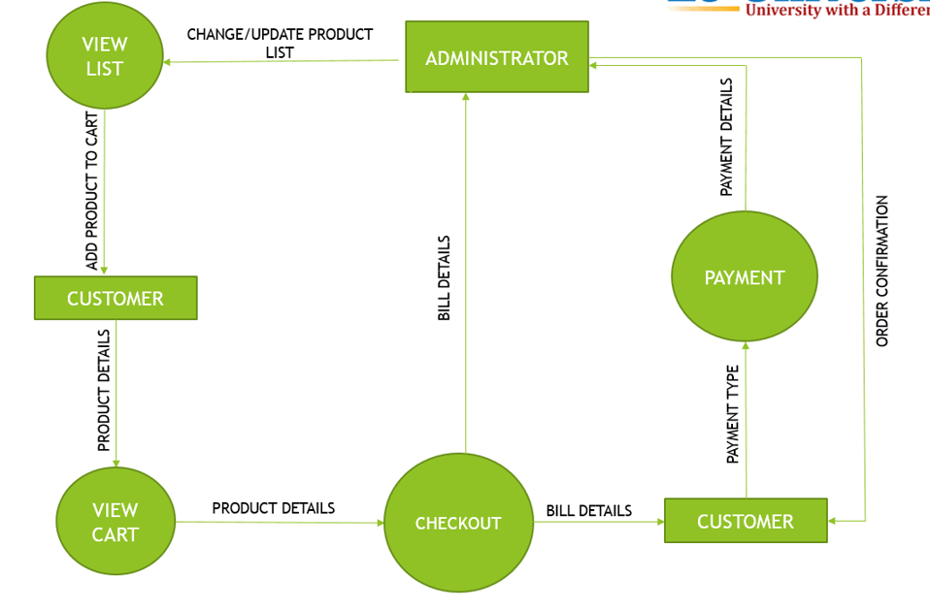
DATA FLOW DIAGRAM

Slide 6
FUNCTIONALITY
PRODUCT SEARCH
CHECKOUT
SHIPPING
ONLINE PAYMENT

Slide 7
ADVANTAGES
By online shopping the customer can save their time.
Online shopping gives us so much variety of products with better prices.
DISADVANTAGES
Lack of significant discounts in online shopping.
The quality of product can be faced by customer while shopping online.

Slide 8
FUTURE SCOPE
We will use An appropriate GUI Interface for eco friendly use.
We will develop the HTML, CSS. And JavaScript for front end Development to making it attractive and eco friendly.
We will interfaced with Real time Database which will help to save data.

Slide 9
THANK YOU…

